Slide 1
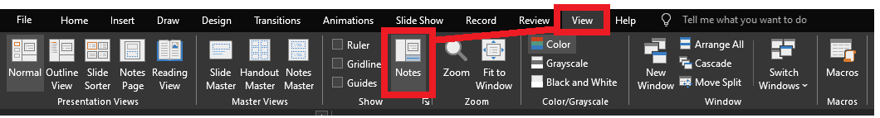
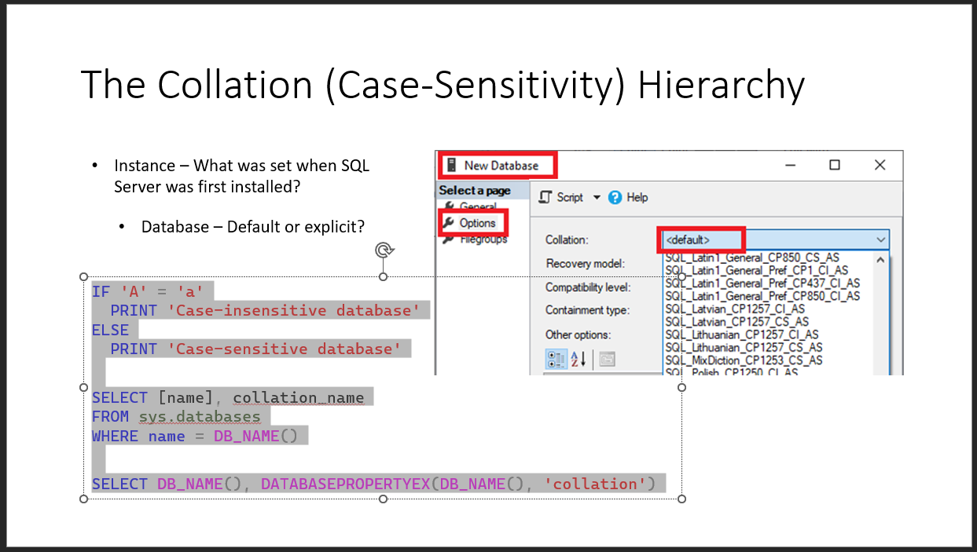
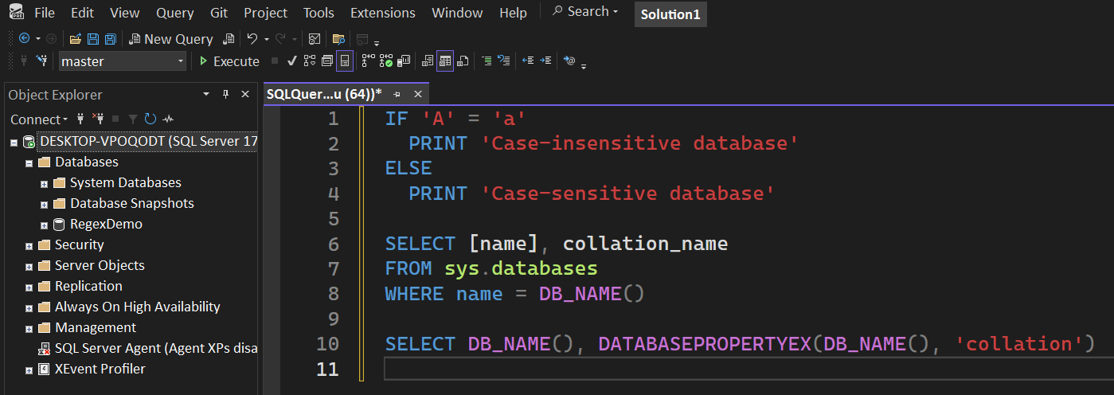
Reviewing after the presentation?
Be sure to enable the Notes for slide-specific content
Slides have working T-SQL that can be copied/pasted into SSMS

Slide 2


Advanced T-SQL Pattern Matching: Leveraging LIKE and Regular Expressions

Slide 3
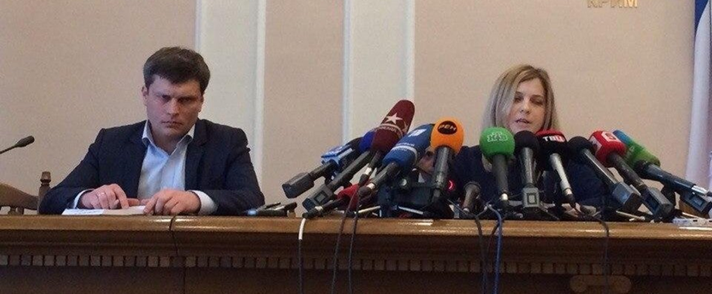
LIKE REGEXP
Notes:
Microsoft introduced Regular Expressions for Azure SQL and Fabric. You’re probably here for the brand new Regular Expressions.
But are you using LIKE effectively? Do you know all the abilities it has?
Before we go into the new shiny toy, let’s level-set on LIKE, get up-to-speed, then we can compare and contrast the REGEXP operators.

Slide 4





Jeff Foushee
SQL Server Database Admin
Programmer
SQL Saturday speaker
Blackjack dealer
https://www.linkedin.com/in/jeff-foushee/
https://github.com/jbfoushee/MyPresentations/

Slide 5
stringable1 LIKE stringable2
SELECT [name], [description]
FROM [SomeTable]
WHERE [description] LIKE ...
“Stringable” refers to anything that can be represented as a string, including numerics, datetimes, guids, etc.

Slide 6

%

Slide 7
% – Wildcard of any non-NULL length (even zero)
WHERE Column1 LIKE '%' -- returns all non-NULL values
WHERE Column1 LIKE 'A%' -- returns values starting with A
WHERE Column1 LIKE '%A' -- returns values ending with A
WHERE Column1 LIKE 'A%B' -- returns values starting with A
and ending with B
WHERE Column1 LIKE '%B%' -- returns values containing B

Slide 8

%

Slide 9

_
[]
[-]
[^]
%
ESCAPE
Notes:
There are more symbols available to LIKE beyond the % character.
If you don’t know about them, you can’t appreciate them.

Slide 10
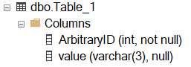
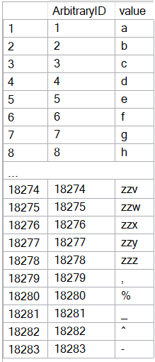
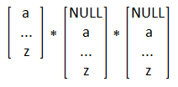
CREATE TABLE dbo.Table_1
( ArbitraryID int IDENTITY(1,1) NOT NULL, [value] varchar(3) )
SET NOCOUNT ON
DECLARE @_text2 varchar(26) = 'abcdefghijklmnopqrstuvwxyz'
DECLARE @_text1 varchar(26) = @_text2
DECLARE @_text0 varchar(26) = @_text1
DECLARE @_p2 tinyint = 0
DECLARE @_p1 tinyint = 0
DECLARE @_p0 tinyint = 0
WHILE 1 = 1
BEGIN
SET @_p2 +=1
IF @_p2 > 26
BEGIN
SET @_p1 += 1
SET @_p2 = 1
END
IF @_p1 > 26
BEGIN
SET @_p0 += 1
SET @_p1 = 1
END
IF @_p0 > 26
BREAK
DECLARE @_text varchar(3) = CONCAT(
SUBSTRING(@_text0, @_p0, 1)
, SUBSTRING(@_text1, @_p1, 1)
, SUBSTRING(@_text2, @_p2, 1) )
INSERT INTO dbo.Table_1 (value) VALUES (@_text)
END
INSERT INTO [dbo].[Table_1] ([value]) VALUES(','), ('%'), ('_'), ('^'), ('-')
INSERT INTO [dbo].[Table_1] ([value]) VALUES(','), ('%'), ('_'), ('^'), ('-')
Notes:
This code will build the sample data used for the demos

Slide 11
_ – Wildcard of one character
Represents a wildcard like %, but for only one non-NULL character
[] – Containment characters
Represent a non-delimited array of allowable characters as one position
% and _ lose their special wildcard ability inside the containment characters
NULL/blank are not acceptable entries for this list
Not nestable. [ also loses its special ability inside the containment characters
Notes:
The underscore guarantees a length of one character per underscore requested.
The container characters enclose an array of characters allowed as one character position

Slide 12
Demo
● LIKE – Wildcard, containment characters

Slide 13
Do I need to worry about case-sensitivity?

Slide 14

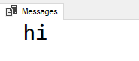
Do I need to worry about case-sensitivity?
No functions -- not even UPPER() and LOWER() -- are case-sensitive
IF UPPER('a') = 'a'
PRINT 'hi'
● LIKE is affected by the current collation
Notes:
If you run this today against your database, chances are you will get these results.
The reason is that your database collation is likely case-insensitive.
The UPPER function is working independently of the collation.

Slide 15
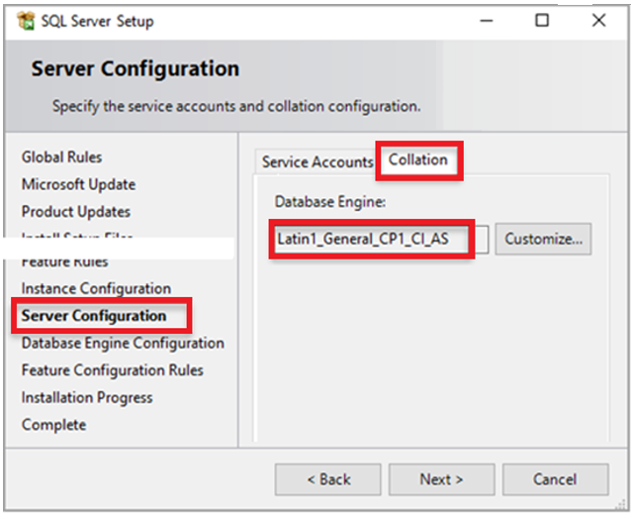
The Collation (Case-Sensitivity) Hierarchy
Instance – What was set when SQL Server was first installed?
SELECT SERVERPROPERTY('collation')
Notes:
The area CI or CS specifies if the instance will follow case-insensitive or case-sensitive collation.
The system databases will receive this collation.

Slide 16
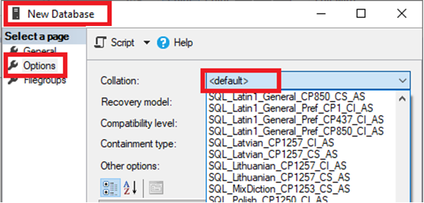
The Collation (Case-Sensitivity) Hierarchy
Instance – What was set when SQL Server was first installed?
Database – Default or explicit?
IF 'A' = 'a'
PRINT 'Case-insensitive database'
ELSE
PRINT 'Case-sensitive database'
SELECT [name], collation_name
FROM sys.databases
WHERE name = DB_NAME()
SELECT DB_NAME(), DATABASEPROPERTYEX(DB_NAME(), 'collation')
Notes:
Again, the area CI or CS specifies if the database will follow case-insensitive or case-sensitive collation
Does the first query look familiar? It should; it’s just a re-hash of IF UPPER(‘a’) = ‘a’…

Slide 17
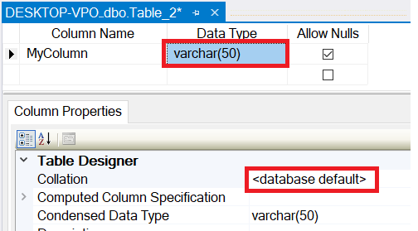
The Collation (Case-Sensitivity) Hierarchy
Instance – What was set when SQL Server was first installed?
Database – Default or explicit?
Table Column – Database default or explicit?
SELECT TABLE_SCHEMA, TABLE_NAME, COLUMN_NAME
, DATA_TYPE
, COLLATION_NAME
, CASE Convert(varchar,IsNull(COLLATION_NAME, ''))
WHEN '' THEN ''
WHEN Convert(varchar, DATABASEPROPERTYEX(DB_NAME(), 'collation')) THEN ''
ELSE '*'
END AS Not_As_DB_Collation
FROM INFORMATION_SCHEMA.COLUMNS
ORDER BY TABLE_SCHEMA, TABLE_NAME, COLUMN_NAME
Notes:
If you don’t use the database default, you are once again presented with all the collation choices.

Slide 18
The Collation (Case-Sensitivity) Hierarchy
Instance – What was set when SQL Server was first installed?
FROM Table_1 t1
INNER JOIN Table_2 t2
ON t1.SomeColumn
COLLATE
SQL_Latin1_General_CP1_CI_AS
= t2.SomeColumn
Database – Default or explicit?
FROM Table_1 t1
INNER JOIN Table_2 t2
ON t1.SomeColumn = t2.SomeColumn
Table Column – Database default or explicit?
Cannot resolve the collation conflict between "SQL_Latin1_General_CP1_CI_AS" and "Latin1_General_CI_AS" in the equal to operation.
Query-level – temporarily treat it differently for calculation purposes
Notes:
You may see this error in the following situations:
Cross-database joins
Linked-server queries
Server was installed with one collation, user database with another. Tempdb is using the same collation

Slide 19
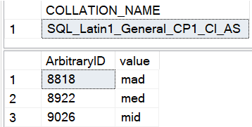
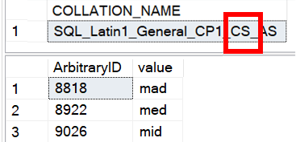
Is LIKE case-sensitive?
No functions -- not even UPPER() and LOWER() -- are case-sensitive
● LIKE is affected by the current collation
-- Request column collation
SELECT isc.COLLATION_NAME
FROM INFORMATION_SCHEMA.COLUMNS isc
WHERE isc.TABLE_NAME = 'Table_1'
AND isc.COLUMN_NAME = 'value'
-- Original query results in CAPS
SELECT t1.ArbitraryID, t1.[value]
FROM Table_1 t1
WHERE t1.[value] LIKE 'm[aei]d'
Case-insensitive DB
Case-sensitive DB
(lower-case)

Slide 20
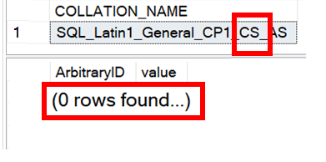
Is LIKE case-sensitive?
No functions -- not even UPPER() and LOWER() -- are case-sensitive
● LIKE is affected by the current collation
-- Request column collation
SELECT isc.COLLATION_NAME
FROM INFORMATION_SCHEMA.COLUMNS isc
WHERE isc.TABLE_NAME = 'Table_1'
AND isc.COLUMN_NAME = 'value'
-- Original query results in CAPS
SELECT t1.ArbitraryID, t1.[value]
FROM Table_1 t1
WHERE t1.[value] LIKE 'M[AEI]D'
Case-insensitive DB
Case-sensitive DB
(upper-case)

Slide 21
What if I need to worry about case-sensitivity?
Forcing case-sensitivity (to lower in example) on an case-insensitive column:
WHERE [CI_value] COLLATE Latin1_General_CS_AS LIKE 'm[aeiou]d'
Forcing case-insensitivity on a case-sensitive column:
WHERE [CS_value] COLLATE Latin1_General_CI_AS LIKE 'm[aeiou]d'
WHERE [CS_value] LIKE '[mM][aAeEiIoOuU][dD]'
WHERE LOWER([CS_value]) LIKE 'm[aeiou]d'
Notes:
If you plan to use these types of queries often, you might consider building a persisted computed column to speed up finding these results. You can index a computed column.

Slide 22
[-] – Range character
Provides a shortcut to consolidate characters on its immediate left and right
Characters must be contiguous; Lower value must be on the left.
[^] – Negation character
Provides a “NOT” to all characters on its right
Must be the FIRST character within the containment characters to take effect

Slide 23
Demo
● LIKE - Range and negation

Slide 24
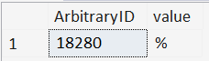
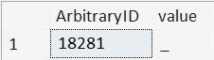
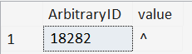
ESCAPE stringable
WHERE [value] LIKE '%\%%' ESCAPE '\'
WHERE [value] LIKE '%%' ESCAPE '%'
WHERE [value] LIKE '%!_%' ESCAPE '!'
WHERE [value] LIKE '%2^%' ESCAPE 2

Slide 25
CASE/WHEN/THEN[/ELSE]/END
Allows conditional logic within queries, enabling different outputs based on specified conditions
SELECT Phone_Number
, CASE WHEN Phone_Number LIKE
'[0-9][0-9][0-9]-[0-9][0-9][0-9]-[0-9][0-9][0-9][0-9]'
THEN '(Valid)'
ELSE ''
END AS isValid
FROM dbo.Employees
Correct syntax
SELECT Phone_Number
, CASE Phone_Number
WHEN LIKE '[0-9][0-9][0-9]-[0-9][0-9][0-9]-...'
THEN '(Valid)'
ELSE ''
END AS isValid
FROM dbo.Employees
Incorrect syntax
Notes:
LIKE is available in the CASE/WHEN/THEN/ELSE/END phrase, but requires a special syntax placement

Slide 26
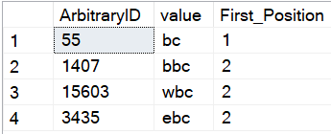
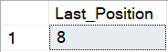
PATINDEX(LIKE_pattern, stringable)
Returns the starting position of the first occurrence of a pattern in a specified expression, or zero if the pattern is not found, on all valid text and character data types.
SELECT TOP 4 ArbitraryID
, [value]
, PATINDEX('%bc', [value]) AS [First_Position]
FROM dbo.Table_1
WHERE [value] LIKE '%bc'
ORDER BY NEWID()
--Find the "last position" using REVERSE()
DECLARE @_value varchar(20) = 'abcdefabcg'
SELECT LEN(@_value)
- PATINDEX(REVERSE('%bc%'), REVERSE(@_value))
AS [Last_Position]

Slide 27
So, like, any questions on LIKE?
Next up, REGEXP_<> functions…
● REGEXP_COUNT()
● REGEXP_LIKE()
● REGEXP_INSTR()
● REGEXP_REPLACE()
● REGEXP_SUBSTR()

Slide 28

Notes:
Regular Expressions is over 70 years old.

Slide 29










Python
JavaScript
Java
C#.NET
Perl
php
Ruby
MySQL
PostgreSQL
Azure SQL DB
Notes:
What is old is new again.

Slide 30



Should I switch to RegEx?
Do I have a compelling reason to switch to RegEx?
WHERE REGEXP_LIKE
(Email,'^[A-Za-z0-9._%+-]+@[A-Za-z0-9.-]+\.[A-Za-z]{2,}$')
WHERE Email LIKE '%@%.%'
Notes:
Is this to satisfy a problem that LIKE can’t solve?
Is the effort closing a sizable gap?
Is the strictness an important piece of data integrity?

Slide 31
Should I switch to RegEx?
Do I have time to learn this complex scripting language?
Each time I return to it?
Notes:
Unfortunately, I won’t be able to teach you everything in one hour, and your payoff may not be immediate.
Every time you come back to a Regular Expression, you will be spending time re-acclimating yourself with the syntax just to get to the logic.

Slide 32
Should I switch to RegEx?
Do I understand RegEx well enough to write in it?
Do I understand all the business rules well enough to (re-)write them in RegEx?

Slide 33



Should I switch to RegEx?
Which of my teammates can troubleshoot RegEx if I write it?
Office Space, 1999

Slide 34
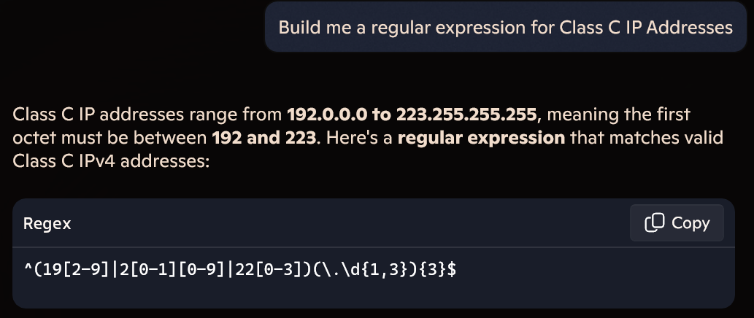
Should I switch to RegEx?
Can I steal a RegEx pattern from the Internet (search or Generative AI)?
Notes:
Generative AI can quickly give a slam-dunk Regex pattern to certain problems.

Slide 35
Should I switch to RegEx?
Can I steal a RegEx pattern from the Internet (search or Generative AI)?
Regular Expression pattern for email address:
^\S+@\S+\.\S+$
^[a-zA-Z0-9_.+-]+@[a-zA-Z0-9-]+\.[a-zA-Z0-9-.]+$
^\w+([-+.']\w+)*@\w+([-.]\w+)*\.\w+([-.]\w+)*$
Notes:
However, in other cases, not even the Internet agrees on an iron-clad solution to a pattern

Slide 36
Mail::RFC822::Address: RegExp-based address validation
(?:(?:\r\n)?[ \t])*(?:(?:(?:[^()<>@,;:\\".\[\] \000-\031]+(?:(?:(?:\r\n)?[ \t])+|\Z|(?=[\["()<>@,;:\\".\[\]]))|"(?:[^\"\r\\]|\\.|(?:(?:\r\n)?[ \t]))*"(?:(?:\r\n)?[ \t])*)(?:\.(?:(?:\r\n)?[ \t])*(?:[^()<>@,;:\\".\[\] \000-\031]+(?:(?:(?:\r\n)?[ \t])+|\Z|(?=[\["()<>@,;:\\".\[\]]))|"(?:[^\"\r\\]|\\.|(?:(?:\r\n)?[\t]))*"(?:(?:\r\n)?[ \t])*))*@(?:(?:\r\n)?[ \t])*(?:[^()<>@,;:\\".\[\] \000-\031]+(?:(?:(?:\r\n)?[ \t])+|\Z|(?=[\["()<>@,;:\\".\[\]]))|\[([^\[\]\r\\]|\\.)*\](?:(?:\r\n)?[ \t])*)(?:\.(?:(?:\r\n)?[ \t])*(?:[^()<>@,;:\\".\[\] \000-\031]+(?:(?:(?:\r\n)?[ \t])+|\Z|(?=[\["()<>@,;:\\".\[\]]))|\[([^\[\]\r\\]|\\.)*\](?:(?:\r\n)?[ \t])*))*|(?:[^()<>@,;:\\".\[\] \000-\031]+(?:(?:(?:\r\n)?[ \t])+|\Z|(?=[\["()<>@,;:\\".\[\]]))|"(?:[^\"\r\\]|\\.|(?:(?:\r\n)?[ \t]))*"(?:(?:\r\n)?[ \t])*)*\<(?:(?:\r\n)?[ \t])*(?:@(?:[^()<>@,;:\\".\[\] \000-\031]+(?:(?:(?:\r\n)?[ \t])+|\Z|(?=[\["()<>@,;:\\".\[\]]))|\[([^\[\]\r\\]|\\.)*\](?:(?:\r\n)?[ \t])*)(?:\.(?:(?:\r\n)?[ \t])*(?:[^()<>@,;:\\".\[\] \000-\031]+(?:(?:(?:\r\n)?[ \t])+|\Z|(?=[\["()<>@,;:\\".\[\]]))|\[([^\[\]\r\\]|\\.)*\](?:(?:\r\n)?[ \t])*))*(?:,@(?:(?:\r\n)?[ \t])*(?:[^()<>@,;:\\".\[\] \000-\031]+(?:(?:(?:\r\n)?[ \t])+|\Z|(?=[\["()<>@,;:\\".\[\]]))|\[([^\[\]\r\\]|\\.)*\](?:(?:\r\n)?[ \t])*)(?:\.(?:(?:\r\n)?[ \t])*(?:[^()<>@,;:\\".\[\] \000-\031]+(?:(?:(?:\r\n)?[ \t])+|\Z|(?=[\["()<>@,;:\\".\[\]]))|\[([^\[\]\r\\]|\\.)*\](?:(?:\r\n)?[ \t])*))*)*:(?:(?:\r\n)?[ \t])*)?(?:[^()<>@,;:\\".\[\] \000-\031]+(?:(?:(?:\r\n)?[ \t])+|\Z|(?=[\["()<>@,;:\\".\[\]]))|"(?:[^\"\r\\]|\\.|(?:(?:\r\n)?[ \t]))*"(?:(?:\r\n)?[ \t])*)(?:\.(?:(?:\r\n)?[ \t])*(?:[^()<>@,;:\\".\[\] \000-\031]+(?:(?:(?:\r\n)?[ \t])+|\Z|(?=[\["()<>@,;:\\".\[\]]))|"(?:[^\"\r\\]|\\.|(?:(?:\r\n)?[ \t]))*"(?:(?:\r\n)?[ \t])*))*@(?:(?:\r\n)?[ \t])*(?:[^()<>@,;:\\".\[\] \000-\031]+(?:(?:(?:\r\n)?[ \t])+|\Z|(?=[\["()<>@,;:\\".\[\]]))|\[([^\[\]\r\\]|\\.)*\](?:(?:\r\n)?[ \t])*)(?:\.(?:(?:\r\n)?[ \t])*(?:[^()<>@,;:\\".\[\] \000-\031]+(?:(?:(?:\r\n)?[ \t])+|\Z|(?=[\["()<>@,;:\\".\[\]]))|\[([^\[\]\r\\]|\\.)*\](?:(?:\r\n)?[ \t])*))*\>(?:(?:\r\n)?[ \t])*)|(?:[^()<>@,;:\\".\[\] \000-\031]+(?:(?:(?:\r\n)?[ \t])+|\Z|(?=[\["()<>@,;:\\".\[\]]))|"(?:[^\"\r\\]|\\.|(?:(?:\r\n)?[ \t]))*"(?:(?:\r\n)?[ \t])*)*:(?:(?:\r\n)?[ \t])*(?:(?:(?:[^()<>@,;:\\".\[\] \000-\031]+(?:(?:(?:\r\n)?[ \t])+|\Z|(?=[\["()<>@,;:\\".\[\]]))|"(?:[^\"\r\\]|\\.|(?:(?:\r\n)?[ \t]))*"(?:(?:\r\n)?[ \t])*)(?:\.(?:(?:\r\n)?[ \t])*(?:[^()<>@,;:\\".\[\] \000-\031]+(?:(?:(?:\r\n)?[ \t])+|\Z|(?=[\["()<>@,;:\\".\[\]]))|"(?:[^\"\r\\]|\\.|(?:(?:\r\n)?[ \t]))*"(?:(?:\r\n)?[ \t])*))*@(?:(?:\r\n)?[ \t])*(?:[^()<>@,;:\\".\[\] \000-\031]+(?:(?:(?:\r\n)?[ \t])+|\Z|(?=[\["()<>@,;:\\".\[\]]))|\[([^\[\]\r\\]|\\.)*\](?:(?:\r\n)?[ \t])*)(?:\.(?:(?:\r\n)?[ \t])*(?:[^()<>@,;:\\".\[\] \000-\031]+(?:(?:(?:\r\n)?[ \t])+|\Z|(?=[\["()<>@,;:\\".\[\]]))|\[([^\[\]\r\\]|\\.)*\](?:(?:\r\n)?[ \t])*))*|(?:[^()<>@,;:\\".\[\] \000-\031]+(?:(?:(?:\r\n)?[ \t])+|\Z|(?=[\["()<>@,;:\\".\[\]]))|"(?:[^\"\r\\]|\\.|(?:(?:\r\n)?[ \t]))*"(?:(?:\r\n)?[ \t])*)*\<(?:(?:\r\n)?[ \t])*(?:@(?:[^()<>@,;:\\".\[\] \000-\031]+(?:(?:(?:\r\n)?[ \t])+|\Z|(?=[\["()<>@,;:\\".\[\]]))|\[([^\[\]\r\\]|\\.)*\](?:(?:\r\n)?[ \t])*)(?:\.(?:(?:\r\n)?[ \t])*(?:[^()<>@,;:\\".\[\] \000-\031]+(?:(?:(?:\r\n)?[ \t])+|\Z|(?=[\["()<>@,;:\\".\[\]]))|\[([^\[\]\r\\]|\\.)*\](?:(?:\r\n)?[ \t])*))*(?:,@(?:(?:\r\n)?[ \t])*(?:[^()<>@,;:\\".\[\] \000-\031]+(?:(?:(?:\r\n)?[ \t])+|\Z|(?=[\["()<>@,;:\\".\[\]]))|\[([^\[\]\r\\]|\\.)*\](?:(?:\r\n)?[ \t])*)(?:\.(?:(?:\r\n)?[ \t])*(?:[^()<>@,;:\\".\[\] \000-\031]+(?:(?:(?:\r\n)?[ \t])+|\Z|(?=[\["()<>@,;:\\".\[\]]))|\[([^\[\]\r\\]|\\.)*\](?:(?:\r\n)?[ \t])*))*)*:(?:(?:\r\n)?[ \t])*)?(?:[^()<>@,;:\\".\[\] \000-\031]+(?:(?:(?:\r\n)?[ \t])+|\Z|(?=[\["()<>@,;:\\".\[\]]))|"(?:[^\"\r\\]|\\.|(?:(?:\r\n)?[ \t]))*"(?:(?:\r\n)?[ \t])*)(?:\.(?:(?:\r\n)?[ \t])*(?:[^()<>@,;:\\".\[\] \000-\031]+(?:(?:(?:\r\n)?[ \t])+|\Z|(?=[\["()<>@,;:\\".\[\]]))|"(?:[^\"\r\\]|\\.|(?:(?:\r\n)?[ \t]))*"(?:(?:\r\n)?[ \t])*))*@(?:(?:\r\n)?[ \t])*(?:[^()<>@,;:\\".\[\] \000-\031]+(?:(?:(?:\r\n)?[ \t])+|\Z|(?=[\["()<>@,;:\\".\[\]]))|\[([^\[\]\r\\]|\\.)*\](?:(?:\r\n)?[ \t])*)(?:\.(?:(?:\r\n)?[ \t])*(?:[^()<>@,;:\\".\[\] \000-\031]+(?:(?:(?:\r\n)?[ \t])+|\Z|(?=[\["()<>@,;:\\".\[\]]))|\[([^\[\]\r\\]|\\.)*\](?:(?:\r\n)?[ \t])*))*\>(?:(?:\r\n)?[ \t])*)(?:,\s*(?:(?:[^()<>@,;:\\".\[\] \000-\031]+(?:(?:(?:\r\n)?[ \t])+|\Z|(?=[\["()<>@,;:\\".\[\]]))|"(?:[^\"\r\\]|\\.|(?:(?:\r\n)?[ \t]))*"(?:(?:\r\n)?[ \t])*)(?:\.(?:(?:\r\n)?[ \t])*(?:[^()<>@,;:\\".\[\] \000-\031]+(?:(?:(?:\r\n)?[ \t])+|\Z|(?=[\["()<>@,;:\\".\[\]]))|"(?:[^\"\r\\]|\\.|(?:(?:\r\n)?[ \t]))*"(?:(?:\r\n)?[ \t])*))*@(?:(?:\r\n)?[ \t])*(?:[^()<>@,;:\\".\[\] \000-\031]+(?:(?:(?:\r\n)?[ \t])+|\Z|(?=[\["()<>@,;:\\".\[\]]))|\[([^\[\]\r\\]|\\.)*\](?:(?:\r\n)?[ \t])*)(?:\.(?:(?:\r\n)?[ \t])*(?:[^()<>@,;:\\".\[\] \000-\031]+(?:(?:(?:\r\n)?[ \t])+|\Z|(?=[\["()<>@,;:\\".\[\]]))|\[([^\[\]\r\\]|\\.)*\](?:(?:\r\n)?[ \t])*))*|(?:[^()<>@,;:\\".\[\] \000-\031]+(?:(?:(?:\r\n)?[ \t])+|\Z|(?=[\["()<>@,;:\\".\[\]]))|"(?:[^\"\r\\]|\\.|(?:(?:\r\n)?[ \t]))*"(?:(?:\r\n)?[ \t])*)*\<(?:(?:\r\n)?[ \t])*(?:@(?:[^()<>@,;:\\".\[\] \000-\031]+(?:(?:(?:\r\n)?[ \t])+|\Z|(?=[\["()<>@,;:\\".\[\]]))|\[([^\[\]\r\\]|\\.)*\](?:(?:\r\n)?[ \t])*)(?:\.(?:(?:\r\n)?[ \t])*(?:[^()<>@,;:\\".\[\] \000-\031]+(?:(?:(?:\r\n)?[ \t])+|\Z|(?=[\["()<>@,;:\\".\[\]]))|\[([^\[\]\r\\]|\\.)*\](?:(?:\r\n)?[ \t])*))*(?:,@(?:(?:\r\n)?[ \t])*(?:[^()<>@,;:\\".\[\] \000-\031]+(?:(?:(?:\r\n)?[ \t])+|\Z|(?=[\["()<>@,;:\\".\[\]]))|\[([^\[\]\r\\]|\\.)*\](?:(?:\r\n)?[ \t])*)(?:\.(?:(?:\r\n)?[ \t])*(?:[^()<>@,;:\\".\[\] \000-\031]+(?:(?:(?:\r\n)?[ \t])+|\Z|(?=[\["()<>@,;:\\".\[\]]))|\[([^\[\]\r\\]|\\.)*\](?:(?:\r\n)?[ \t])*))*)*:(?:(?:\r\n)?[ \t])*)?(?:[^()<>@,;:\\".\[\] \000-\031]+(?:(?:(?:\r\n)?[ \t])+|\Z|(?=[\["()<>@,;:\\".\[\]]))|"(?:[^\"\r\\]|\\.|(?:(?:\r\n)?[ \t]))*"(?:(?:\r\n)?[ \t])*)(?:\.(?:(?:\r\n)?[ \t])*(?:[^()<>@,;:\\".\[\] \000-\031]+(?:(?:(?:\r\n)?[ \t])+|\Z|(?=[\["()<>@,;:\\".\[\]]))|"(?:[^\"\r\\]|\\.|(?:(?:\r\n)?[ \t]))*"(?:(?:\r\n)?[ \t])*))*@(?:(?:\r\n)?[ \t])*(?:[^()<>@,;:\\".\[\] \000-\031]+(?:(?:(?:\r\n)?[ \t])+|\Z|(?=[\["()<>@,;:\\".\[\]]))|\[([^\[\]\r\\]|\\.)*\](?:(?:\r\n)?[ \t])*)(?:\.(?:(?:\r\n)?[ \t])*(?:[^()<>@,;:\\".\[\] \000-\031]+(?:(?:(?:\r\n)?[ \t])+|\Z|(?=[\["()<>@,;:\\".\[\]]))|\[([^\[\]\r\\]|\\.)*\](?:(?:\r\n)?[ \t])*))*\>(?:(?:\r\n)?[ \t])*))*)?;\s*)
6342 characters
https://pdw.ex-parrot.com/Mail-RFC822-Address.html
Notes:
Or the pattern is so ridiculous that it’s not maintainable. This is the Internet Engineering Task Force (IETF) standard for email addresses.

Slide 37
Should I switch to RegEx?
Can I steal a RegEx pattern from the Internet (search or Generative AI)?
(Does the Internet agree on a pattern?)

Slide 38
Additional points?

Slide 39

Key Differences between LIKE and REGEXP_<>
A default LIKE search matches the sensitivity of the database collation
(We discussed this earlier)
A default REGEXP_<> search is case-sensitive,
irrespective of database collation

Slide 40
Key Differences between LIKE and REGEXP_<>
The pattern provided to LIKE implies beginning, middle, end, and length based on the characters given to it
mad
med
mid
mod
mud
WHERE [value] LIKE 'm[aeiou]d'
Implied start Implied end

Slide 41

Key Differences between LIKE and REGEXP_<>
The pattern provided to REGEXP_<> is allowed to appear anywhere in the string to match. Additional directives are applied to specify beginning and end of string.
1. WHERE REGEXP_LIKE([value], 'm[aeiou]d')
2. WHERE REGEXP_LIKE([value], '^m[aeiou]d')
3. WHERE REGEXP_LIKE([value], 'm[aeiou]d$')
+
(Start-of-text character)
(End-of-text character)

Slide 42
Key Differences between LIKE and REGEXP_<>
The pattern provided to REGEXP_<> is allowed to appear anywhere in the string to match. Additional directives are applied to specify beginning and end of string.
Clause 1 | Clause 2 | Clause 3
m[aeiou]d | ^m[aeiou]d | m[aeiou]d$
mad | mad | mad
maddening | maddening | maddening
med | med | med
mid | mid | mid
mod | mod | mod
mud | mud | mud
nomad | nomad | nomad
1. WHERE REGEXP_LIKE([value], 'm[aeiou]d')
2. WHERE REGEXP_LIKE([value], '^m[aeiou]d')
3. WHERE REGEXP_LIKE([value], 'm[aeiou]d$')

Slide 43
The similarities…
Pattern | LIKE | REGEXP
Any one character from a selection | [abc] | [abc]
Any character not in the selection | [^abc] | [^abc]
Any one character in the range | [a-g] | [a-g]
Any numeric in the range | [1-4] | [1-4]

Slide 44
Some transcribed syntax for characters…
Pattern | LIKE | REGEXP
Exactly 1 character (ignoring \n) | _ | .
 |  | .{1}
Any 0+ characters (ignoring \n) | % | .*
 |  | .{0,}
Any 1+ characters (ignoring \n) | _% | .+
 |  | .{1,}
Escaping a symbol | '!_' ESCAPE '!' | \.
“Quantifiers”
Notes:
Quantifiers allow you to build a specific, a range, an “at-most”, or an “at-least” construct of patterns.

Slide 45
Some transcribed syntax for numerics…
Pattern | LIKE | REGEXP
Exactly 1 numeric | [0-9] | [0-9]
 |  | [0-9]{1}
 |  | \d{1}
Any 0+ numerics | n/a | [0-9]*
 |  | [0-9]{0,}
 |  | \d*
 |  | \d{0,}
Any 1+ numerics | n/a | [0-9]+
 |  | [0-9]{1,}
 |  | \d+
 |  | \d{1,}
“Metacharacters”

Slide 46
Too complex for LIKE…
Pattern | LIKE | REGEXP
Exactly n numeric characters |  | [0-9]{n}
At least n numeric characters |  | [0-9]{n,}
Between n and m numeric characters |  | [0-9]{n,m}
Any one phrase from a selection |  | (oh|on)
Any one phrase, repeated n times |  | (oh|on){n}
Either zero or one lowercase letter |  | [a-z]?

Slide 47
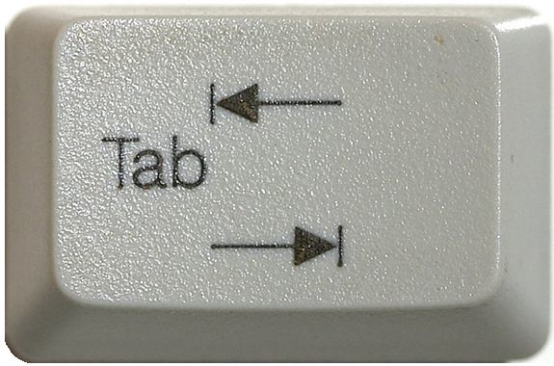

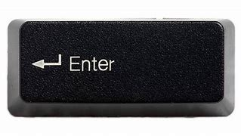
The metacharacters… easier or harder?
([0-9]|[a-zA-Z]|[!@$%&]|[ ]) → .
([0-9]|[a-zA-Z]|[!@$%&]|[ ]) → \d
([0-9]|[a-zA-Z]|[!@$%&]|[ ]) → \D
([0-9]|[a-zA-Z]|[!@$%&]|[ ]) → \w
([0-9]|[a-zA-Z]|[!@$%&]|[ ]) → \W
([0-9]|[a-zA-Z]|[!@$%&]|[ ]) → \s
([0-9]|[a-zA-Z]|[!@$%&]|[ ]) → \S
Newline goes in
this lane, right?
Depends. 🤷❓
Stay tuned for “flags”
Notes:
The period denotes a single character, including the period. Whether or not it includes the newline character depends on “flags,” which will be discussed later.
The “\d” metacharacter stands for the “digit” characters. Capitalizing to “\D” gives the inverse of this list: everything that is not a digit.
The “\w” metacharacter stands for “word” characters. Capitalizing to “\W” includes anything not found in a word
The “\s” metacharacter stands for “whitespace” characters. Capitalizing to “\S” includes anything not considered whitespace.

Slide 48
Basic REGEXP_<> syntax
char,
nchar,
varchar (MAX),
nvarchar (MAX)
<REGEXP_FUNC>(string_or_stringColumn
, RegExPtrn
)
Notes:
All RegExp functions apply to some string and will at least require a Regular Expression pattern.

Slide 49
Basic REGEXP_<> syntax
<REGEXP_FUNC>(string_or_stringColumn
, RegExPtrn
, Param1
, Param2
, flags
, Param4
)
Notes:
All of them will also have one or more additional parameters, but they will have default values

Slide 50
Basic REGEXP_<> syntax
<REGEXP_FUNC>(string_or_stringColumn
, RegExPtrn
[, Param1 = 'default']
[, Param2 = 'default']
[, flags = 'default']
[, Param4 = 'default']
)
Notes:
The way SQL Server designed the function though, is the parameter ordering is very specific, since most of the values are numbers

Slide 51
Basic REGEXP_<> syntax
<REGEXP_FUNC>(string_or_stringColumn
, RegExPtrn
[, Param1 = 'default'
[, Param2 = 'default'
[, flags = 'default'
[, Param4 = 'default'
]
]
]
)
Notes:
You do not have to provide values to any optional default parameters

Slide 52
Basic REGEXP_<> syntax
<REGEXP_FUNC>(string_or_stringColumn
, RegExPtrn
[, Param1 = 'default'
[, Param2 = 'default'
[, flags = 'default'
[, Param4 = 'default'
]
]
]
)
Notes:
But if I want to edit this parameter to a non-default value…

Slide 53
Basic REGEXP_<> syntax
<REGEXP_FUNC>(string_or_stringColumn
, RegExPtrn
, Param1 = 'default'
, Param2 = 'value'
[, flags = 'default'
[, Param4 = 'default'
]
)
Notes:
I have to explicitly request all preceding parameters and values before it, even if I repeat the default value

Slide 54
<REGEXP_FUNC>(stringable, RegExPtrn...[,flags='c'])
Flag | Mode | Description
i | Ignore case | Performs case-insensitive matching.
c | Default | Performs case-sensitive matching. (default)
s | “Dot-all” | Allows the period (.), to match the newline character (\n)
m | Multi-line | ^ and $ match “begin/end line” in addition to “begin/end text”
Notes:
Oracle uses very similarly-named functions. The s-flag is replaced by the n-character in Oracle.

Slide 55
Build some example data
CREATE TABLE dbo.Employees (
ID INT IDENTITY(101,1),
[Name] VARCHAR(150),
Email VARCHAR(320),
Phone_Number VARCHAR(20)
);
INSERT INTO dbo.Employees ([Name], Email, Phone_Number)
VALUES ('John Doe', 'john@contoso.com', '123-456-7890')
, ('Alice Smith', 'alice@fabrikam.com', '234-567-8901')
, ('Bob Johnson', 'bob@fabrikam.net','345-678-9012')
, ('Eve Jones', 'eve@contoso.com', '456-789-0123')
, ('Charlie Brown', 'charlie@contoso.co.in', '567-890-124');
Bad data
https://devblogs.microsoft.com/azure-sql/introducing-regular-expression-regex-support-in-azure-sql-db/

Slide 56
REGEXP_COUNT ( string, RegExPtrn [,startPos = 1 [,flags = 'c']] )
Returns the number of times a regular-expression pattern matches within a string
REGEXP_LIKE(string, RegExPtrn [,flags='c'])
Determines if a string matches a regular expression.
REGEXP_INSTR (string, RegExPtrn [,startPos = 1 [,occurrence = 1
[,return_option = 0 [,flags = 'c']]]] )
From the starting position of some string, find the nᵗʰ occurrence of a Regex pattern, and return its starting/ending position (based on return_option).

Slide 57
Demo
● REGEXP_COUNT
● REGEXP_LIKE
● REGEXP_INSTR

Slide 58
Sub-expressions
SELECT ID, Phone_Number
FROM dbo.Employees
WHERE REGEXP_LIKE(Phone_Number
, '^\d{3}-\d{3}-(9012|0123)$' )
(9012|0123)
Notes:
Earlier while talking about REGEXP_LIKE, we saw the use of parenthesis.
We used them to “wall-off” a list of acceptable values within a certain portion of the pattern.
The pattern contained within parenthesis is called a sub-expression.

Slide 59
Sub-expressions
SELECT ID, Phone_Number
FROM dbo.Employees
WHERE REGEXP_LIKE(Phone_Number
, '^(\d{3})-(\d{3})-(9012|0123)$' )
\1 \2 \3
Notes:
And we can wall-off anything inside a regular expression, even it leaves one option within.

Slide 60
REGEXP_REPLACE ( string, RegExPtrn, withPattern [, startPos = 1 [, occurrence = 0 [, flags = 'c']]] )
Functions supporting sub-expressions
Returns an in-string replacement of one regular expression pattern, with another regular expression pattern.
REGEXP_SUBSTR (string, RegExPtrn [,startPos = 1 [,occurrence = 1
[,flags = 'c' [,whichSubExp = 0]]]] )
Extracts a substring -- matching a regular expression pattern -- found within a string
Notes:
Using REGEXP_REPLACE, we can redecorate data using sub-expressions.
Sub-expressions are numbered based on their creation from left-to-right
SQL Server only supported numbered expressions at this time.
If the data does not meet the criteria of the regular expression, it is returned with no modifications.

Slide 61
Demo
● REGEXP_REPLACE
● REGEXP_SUBSTR

Slide 62
Flags revisited…
Flag | Mode | Description
i | Ignore case | Performs case-insensitive matching.
c | Default | Performs case-sensitive matching. (default)
s | “Dot-all” | Allows the period (.), to match the newline character (\n)
m | Multi-line | ^ and $ match “begin/end line” in addition to “begin/end text”
Notes:
Oracle uses very similarly-named functions. The s-flag is replaced by the n-character in Oracle.

Slide 63
Flags revisited…
Mixed-casing within multi-line
SELECT REGEXP_COUNT('this is a line
This is another line
Third line', '^Thi' [,...]) AS [Count]
Multi-line
Line starts with “Thi”
Flags go here…

Slide 64
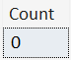
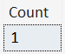
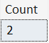
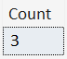
Flags revisited…
SELECT REGEXP_COUNT('this is a line
This is another line
Third line', '^Thi', 1, 'sc') AS [Count]
SELECT REGEXP_COUNT('this is a line
This is another line
Third line', '^Thi', 1, 'si') AS [Count]
SELECT REGEXP_COUNT('this is a line
This is another line
Third line', '^Thi', 1, 'mc') AS [Count]
SELECT REGEXP_COUNT('this is a line
This is another line
Third line', '^Thi', 1, 'mi') AS [Count]

Slide 65
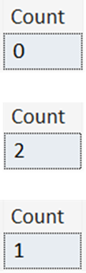
Flags revisited…
SELECT REGEXP_COUNT('Hello World
hello universe
HELLO AGAIN!
hello multi-line match!'
, '^hello.*$', 1, 'sc') AS [Count]
SELECT REGEXP_COUNT('Hello World
hello universe
HELLO AGAIN!
hello multi-line match!'
, '^hello.*$', 1, 'mc') AS [Count]
SELECT REGEXP_COUNT('Hello World
hello universe
HELLO AGAIN!
hello multi-line match!'
, '^hello.*$', 1, 'msc') AS [Count]
Notes:
The m and s flags are not mutually exclusive: they can be combined.

Slide 66
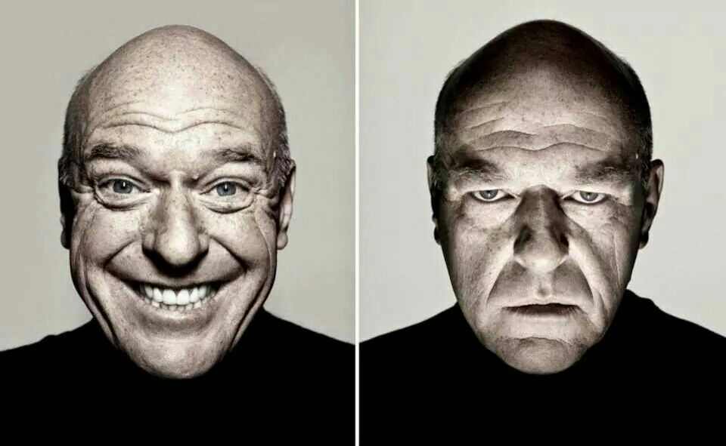
Closing Thoughts…
Developer
DBA

Slide 67
Demo
https://regex101.com/
Four score and seven years ago our fathers brought forth, upon this continent, a new nation, conceived in liberty, and dedicated to the proposition that all men are created equal.
Now we are engaged in a great civil war, testing whether that nation, or any nation so conceived, and so dedicated, can long endure. We are met on a great battle field of that war. We come to dedicate a portion of it, as a final resting place for those who died here, that the nation might live. This we may, in all propriety do.

Slide 68
Performance
SELECT [Name], Email, REGEXP_INSTR(email, '@') AS [Position_of_@]
FROM Employees
WHERE REGEXP_INSTR(email, '@') > 0
SELECT [Name], Email, CHARINDEX('@', email ) AS [Position_of_@]
FROM Employees
WHERE Email LIKE '%@%'

Slide 69
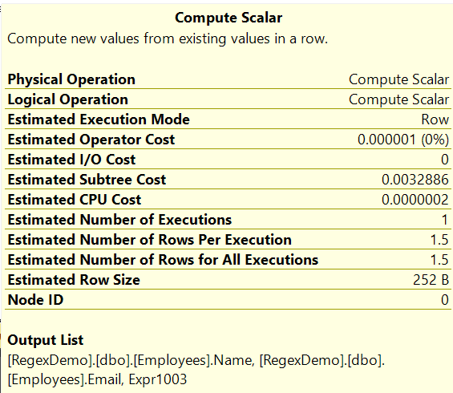
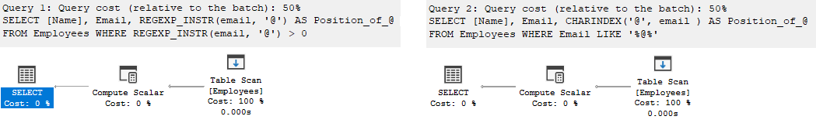
Performance
SELECT [Name], Email, REGEXP_INSTR(email, '@') AS [Position_of_@]
FROM Employees
WHERE REGEXP_INSTR(email, '@') > 0
SELECT [Name], Email, CHARINDEX('@', email ) AS [Position_of_@]
FROM Employees
WHERE Email LIKE '%@%'
Query 1 (relative to the batch): 50% Query 2 (relative to the batch): 50%

Slide 70
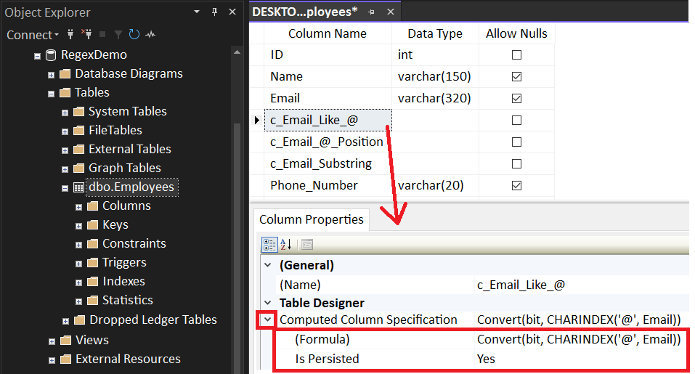
Computed Column
ALTER TABLE dbo.Employees
ADD c_Email_Like_@ AS Convert(bit, CHARINDEX('@', Email)) PERSISTED
, c_Email_@_Position AS CHARINDEX('@', Email) PERSISTED
, c_Email_Substring AS SUBSTRING(Email, 8, 1) PERSISTED

Slide 71
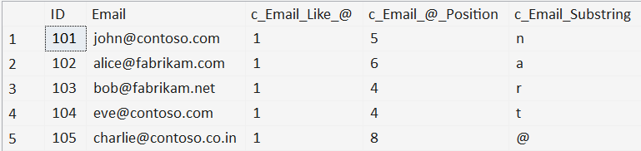
Computed Column
ALTER TABLE dbo.Employees
ADD c_Email_Like_@ AS CONVERT(bit, CHARINDEX('@', Email)) PERSISTED
, c_Email_@_Position AS CHARINDEX('@', Email) PERSISTED
, c_Email_Substring AS SUBSTRING(Email, 8, 1) PERSISTED
SELECT [ID]
, [Email]
, [c_Email_Like_@]
, [c_Email_@_Position]
, [c_Email_Substring]
FROM [dbo].[Employees]
WHERE [c_Email_Like_@] = 1
OR [c_Email_@_Position] > 0
OR [c_Email_Substring] = '@'

Slide 72
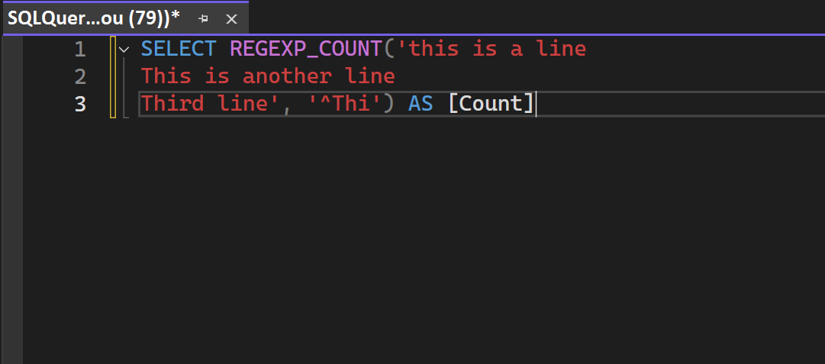
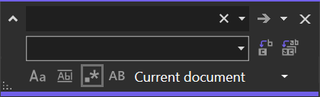
SSMS Find/Replace

Slide 73
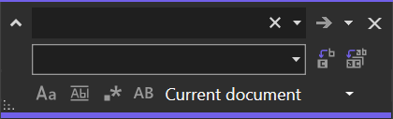
SSMS Find/Replace
(Find box)
(Replace box)
●
●
●
Match Case: Denotes if a case-sensitive search is performed for the subject
Match Whole Word: Denotes if additional alphabetic characters leading or
trailing the subject voids the result
Preserve Case: On replacement, maintain the original casement of the subject
(lowercase, UPPERCASE, Proper Case)

Slide 74
SSMS Find/Replace
(Find box)
(Replace box)
●
Regex Mode: Interprets the Find/Replace boxes as Regular Expression directives

Slide 75
Demo (if time allows)
SSMS – Find/Replace in Regex Mode

Slide 76



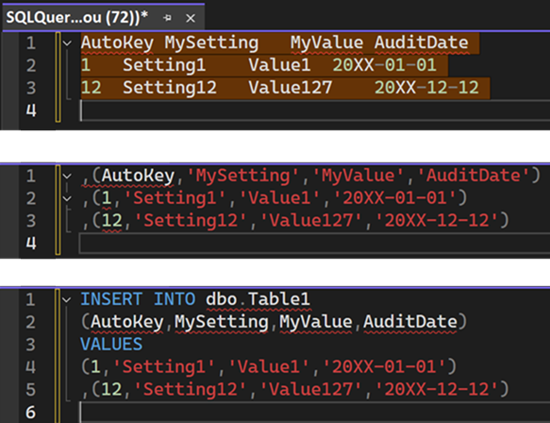
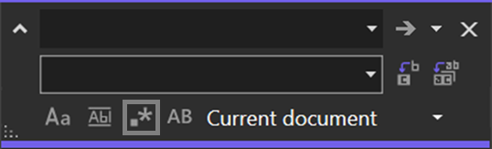
SSMS Find/Replace
^(.*)\t(.*)\t(.*)\t([^\r]*)$
,($1,'$2','$3','$4')
(Minor manual clean-up)
Notes:
$ only matches \n (newline), not \r (carriage return).
Thanks to Erin Stellato at Microsoft for help with this.

Slide 77
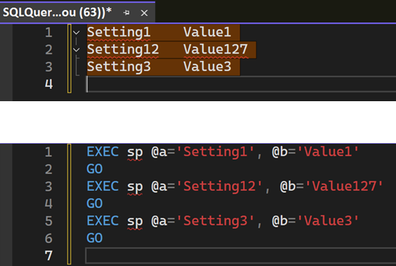
SSMS Find/Replace
^(.*)\t([^\r]*)$
EXEC sp @a='$1', @b='$2'\nGO
Notes:
$ only matches \n (newline), not \r (carriage return).
Thanks to Erin Stellato at Microsoft for help with this.

Slide 78
Where do we go from here?
Learned more than just % for LIKE
Scratched the surface on Regular Expression syntax
Introduced to the REGEXP functions
● REGEXP_COUNT()
● REGEXP_LIKE()
● REGEXP_INSTR()
● REGEXP_REPLACE()
● REGEXP_SUBSTR()
Experienced the Regex mode of SSMS Find/Replace

Slide 79
Jeff Foushee
SQL Server Database Admin
Programmer
SQL Saturday speaker
Blackjack dealer
https://www.linkedin.com/in/jeff-foushee/
https://github.com/jbfoushee/MyPresentations/

Slide 80

Advanced T-SQL Pattern Matching: Leveraging LIKE and Regular Expressions
https://github.com/jbfoushee/MyPresentations/

